Slide 1



PAS10 High Level Scope Summary
October 18, 2016

Slide 2
PAS10 Release Scope Overview
Work Item Category | User Story Count
WI0162 CA HDES Conversion | 57
WI0208 CA Prop Conversion SIS-DP3 and Foxpro-PUP | 53
WI0237 Overall Prod Enhancements and Defect Debt PAS10 | 2
WI0316 Property PAS Simplification Phase 2 | 9
WI0329 Grandfathering Rules for MAIG States | 29
WI0330 3rd party cover page for Non-Pay Cancel Notice-CA Property | 2
WI0333 UBI Enhancements | 19
WI0340 Enable Book roll in New Business and Capping | 16
WI0342 UW Simplification - Phase 1 | 45
WI0344 Left-over Auto or Property CRs | 22
Grand Total | 254
Note:
Story counts are as per RTC extract as on 13th Oct, 2016
24 out of 29 MAIG stories are cancelled

Slide 3
Regression Scope Summary - CA HDES Conversions (1/2)

Slide 4
Regression Scope Summary - CA HDES Conversions (2/2)

Slide 5
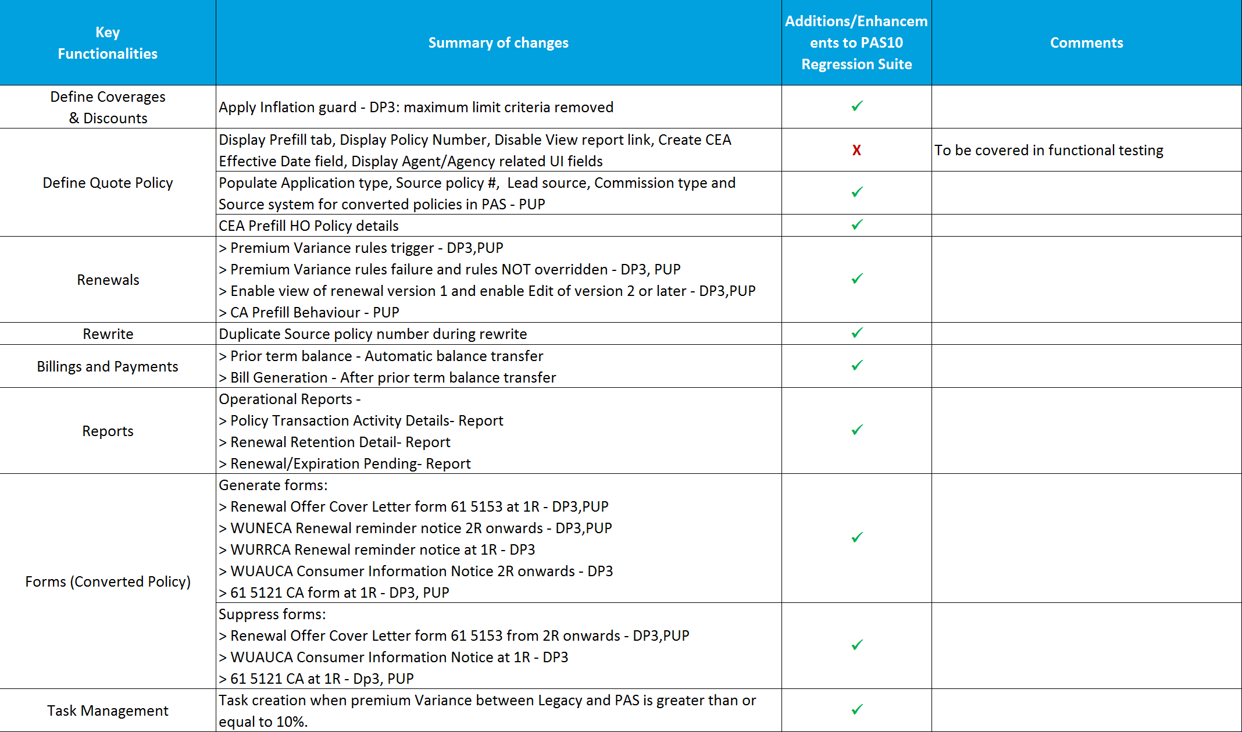
Regression Scope Summary - CA SIS/Foxpro Conversions

Slide 6
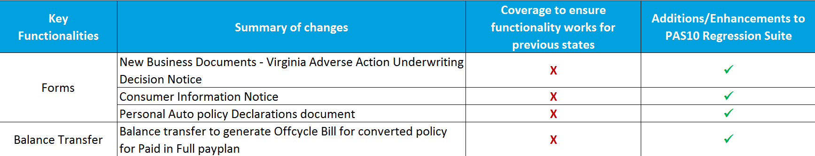
Regression Scope Summary – MAIG Conversions

Slide 7
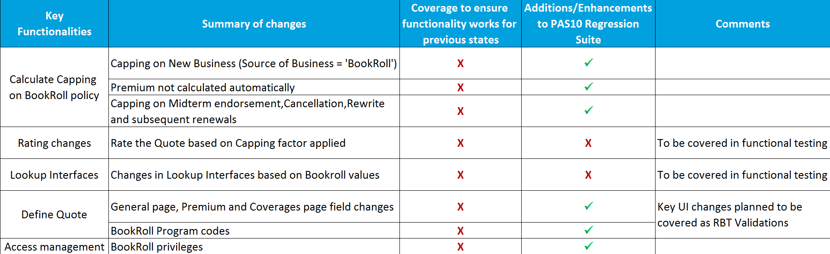
Regression Scope Summary – Book Roll and Capping

Slide 8
Regression Scope Summary – Other Work Item Categories
WI0333 UBI Enhancements
Removal criteria for telematics participation discount and its subsequent impact on various documents and UI is introduced as part of PAS10.
WI0342 – UW Simplification - Phase 1
Automated exception rules 2 & 3 are merged into automated exception 1 flow
Automated exception 4 is replaced by a separate requirement for eligibility based on PPC
Automated exception 6 is replaced by a separate requirement for eligibility based on fire line score
WI0344 – Left–over Auto or Property
Update to application, declaration, quote documents based on form title update for HS 04 90
Various other enhancements related to task management, prefill behavior etc.

Slide 9
Regression Scope Summary – Other Work Item Categories
WI0316 Property PAS Simplification Phase 2
Removal of eligibility related questions for endorsement HS 24 73, HS 04 59, HS 09 88 and HS 04 42
Capture Mortgagee Info and attach 438bfuns endorsement
WI0237 Overall Prod Enhancements and Defect Debt PAS10
Defects pertaining to field validation and list of values
WI0330 3rd party cover page for Non-Pay Cancel Notice-CA Property
Cancellation notice and third party designee cover page

Slide 10
Thank You

